Slide 1

CS4157
Software Quality
Notes:
CS5707 Software Development Paradigms
John Dawson
CS5707 Software Development Paradigms
John Dawson
CS5707 Software Development Paradigms
John Dawson

Slide 2
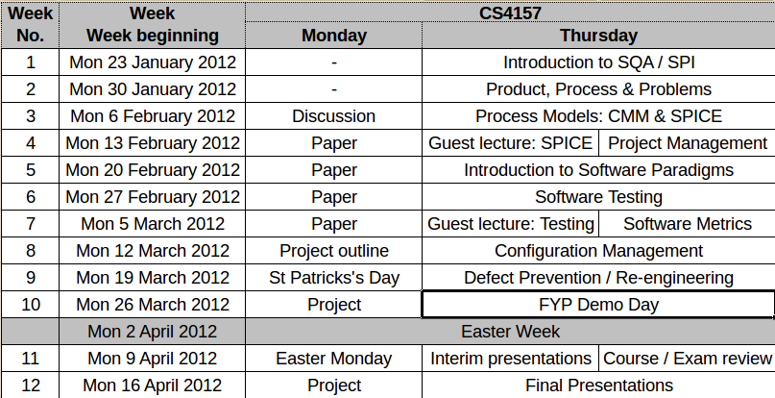
Module Schedule

